Slide 1
SQL FOR DATA ANALYSIS
Scope
IT SQL
Data Analysis SQL
DBA
BI/Data analyst

Slide 2
SQL FOR DATA ANALYSIS
Business Data analysis
Business analyst
BI/Data analyst

Slide 3
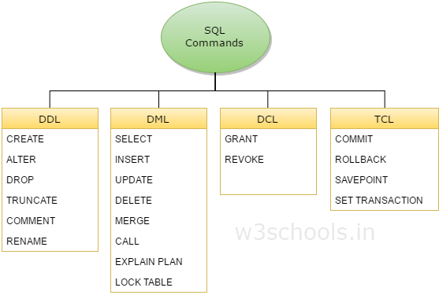
SQL FOR DATA ANALYSIS
DML: Data Manipulation Language

Slide 4
SQL FOR DATA ANALYSIS
Table of content
SELECT Statement Practice
where Statement Practice
JOIN Statement Practice
INNER JOIN Statement Practice
RIGHT & LEFT JOIN Statement Practice
union Statement Practice
Union vs union all Statement Practice
intercept vs except Statement Practice
aggregation Statement Practice
SORT Statement Practice
Group by Statement Practice
Having Statement Practice
String Statement Practice
Date Statement Practice
null Statement Practice
cast Statement Practice
derived Statement Practice
with Statement Practice
case Statement Practice
Create, insert, update, delete Statement Practice

Slide 5
SQL FOR DATA ANALYSIS
Resume: how to use SQL to do data analysis
Interview: demo how you use SQL at work

Slide 6
SQL FOR DATA ANALYSIS
Server
Database
tables
IT
SSMS:Client
AD HOC analysis/data pull
ETL

Slide 7
SQL FOR DATA ANALYSIS
AD HOC analysis
Business Requirements
Technical Requirements
SQL Query
Deliver Result
Communication skills: Understand Business Language
Communication skill:
explain technical terms to business terms

Slide 8
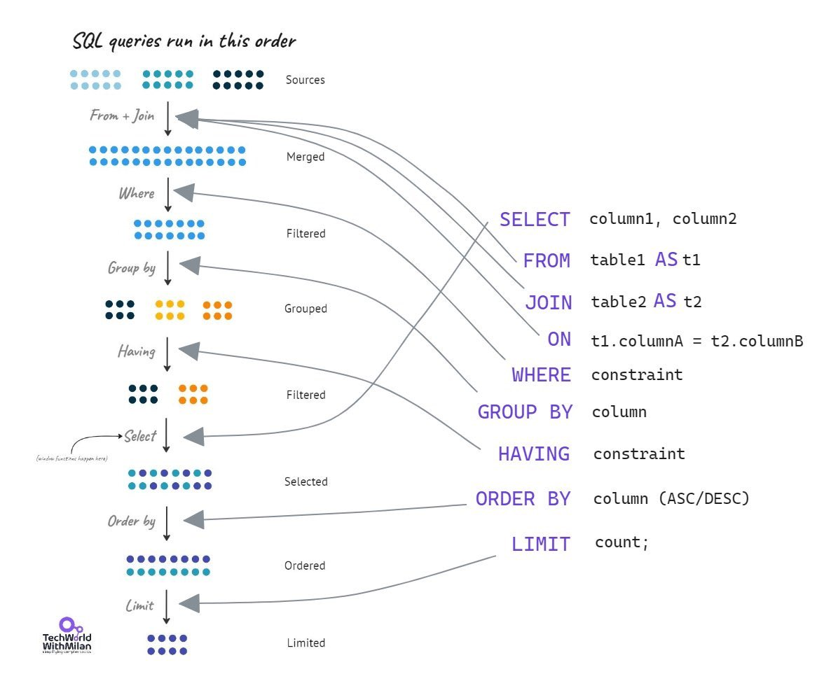
SQL FOR DATA ANALYSIS

Slide 9
SQL FOR DATA ANALYSIS
SELECT Statement Practice
1) Retrieve all rows from the HumanResources.Employee table. Return only the NationalIDNumber column.
2) Retrieve all rows from the HumanResources.Employee table. Return the NationalIDNumber and JobTitle columns.
3) Retrieve the top 10 percent of rows from the HumanResources.Employee table. Return the NationalIDNumber, JobTitle and BirthDate columns.
4) Retrieve the top 100 rows from the HumanResources.Employee table. Return the NationalIDNumber, JobTitle and BirthDate columns. Give the NationalIDNumber column an alias, “SSN”, and the JobTitle column an alias, “Job Title”.
5) Return all rows and all columns from the Sales.SalesOrderHeader table.
6) Return the top 50 percent of rows and all columns from the Sales.Customer table.
7) Return the Name column from the Production.vProductAndDescription view. Give this column an alias “Product’s Name”.
8) Return the top 400 rows from HumanResources.Department
9) Return all rows and columns from the table named Production.BillOfMaterials
10) Return the top 1500 rows and columns from the view named Sales.vPersonDemographics

Slide 10
SQL FOR DATA ANALYSIS
SELECT Statement Practice
Question 1: SELECT NationalIDNumber FROM HumanResources.Employee
Question 2: SELECT NationalIDNumber, JobTitle FROM HumanResources.Employee
Question 3: SELECT TOP 10 PERCENT NationalIDNumber, JobTitle, BirthDate FROM HumanResources.Employee
Question 4: SELECT TOP 100 NationalIDNumber AS SSN, JobTitle AS [Job Title], BirthDate FROM HumanResources.Employee
Question 5: SELECT * FROM Sales.SalesOrderHeader
Question 6: SELECT TOP 50 PERCENT * FROM Sales.Customer
Question 7: SELECT Name AS [Product's Name] FROM Production.vProductAndDescription
Question 8: SELECT TOP 400 * FROM HumanResources.Department
Question 9: SELECT * FROM Production.BillOfMaterials
Question 10: SELECT TOP 1500 * FROM Sales.vPersonDemographics

Slide 11
SQL FOR DATA ANALYSIS
SELECT Statement Practice
1) Execute a literal select statement that returns your name.
2) Write the literal select statement that evaluates the product of 7 and 4.
3) Write the literal select statement that takes the difference of 7 and 4 then multiplies that difference by 8.
4) Write a literal select statement that returns the phrase “BDA’s SQL Training Class”. (Hint: note the single apostrophe in the string).
5) Execute a literal SELECT statement that returns the phrase “Day 1 of Training” in one column and the result of 5*3 in another column.

Slide 12
SQL FOR DATA ANALYSIS
SELECT Statement Practice
Question 1: SELECT 'FirstName LastName’
Question 2: SELECT 7*4
Question 3: SELECT (7-4)*8
Question 4: SELECT ‘BDA''s SQL Training Class’
Question 5: SELECT 'Day 1 of Training', 5*3

Slide 13
SQL FOR DATA ANALYSIS
where Statement Practice
1) Return the FirstName and LastName columns from Person.Person where the FirstName column is equal to “Mark”
2) Find the top 100 rows from Production.Product where the ListPrice is not equal to 0.00
3) Return all rows and columns from the view HumanResources.vEmployee where the employee’s last name starts with a letter less than “D”
4) Return all rows and columns from Person.StateProvince where the CountryRegionCode column is equal to “CA”
5) Return the FirstName and LastName columns from the view Sales.vIndividualCustomer where the LastName is equal to “Smith”. Give the column alias “Customer First Name” and “Customer Last Name” to the FirstName and LastName columns respectively.
6) Using the Sales.vIndividualCustomer view, find all customers with a CountryRegionName equal to “Australia” or all customers who have a PhoneNumberType equal to “Cell” and an EmailPromotion column value equal to 0. (Hint: the correct query requires the use of parentheses in your WHERE clause)
7) Find all employees from the view HumanResources.vEmployeeDepartment who have a Department column value in the list of: “Executive”, “Tool Design”, and “Engineering”. Complete this query twice – once using the IN operator in the WHERE clause and a second time using multiple OR operators.
8) Using HumanResources.vEmployeeDepartment, find all employees who have a StartDate between July 1, 2000 and June 30, 2002. Complete this query twice – once using the BETWEEN operator and then by using a combination of the “greater than or equal to” and “less than or equal to” operators.
9) Find all customers from the view Sales.vIndividualCustomer whose LastName starts with the letter “R”. (Hint: a wildcard character can assist you with this query)
10) Find all customers from the view Sales.vIndividualCustomer whose LastName ends with the letter “r”. (Hint: a wildcard character can assist you with this query)
11) Find all customers from the view Sales.vIndividualCustomer whose LastName is either “Lopez”, “Martin”, or “Wood” and whose FirstName starts with any letter between “C” and “L” in the alphabet. (Hint: multiple wildcard characters will be used in this query)
12) Return all columns from the Sales.SalesOrderHeader table for all sales that are associated with a sales person. That is, return all rows where the SalesPersonID column does not contain a NULL value.
13) Return the SalesPersonID and TotalDue columns from Sales.SalesOrderHeader for all sales that do not have a NULL value in the SalesPersonID column and whose TotalDue value exceeds $70,000

Slide 14
SQL FOR DATA ANALYSIS
where Statement Practice
Question 1: SELECT FirstName, LastName FROM Person.Person WHERE FirstName = 'Mark'
Question 2: SELECT TOP 100 * FROM Production.Product WHERE ListPrice <> 0.00
Question 3: SELECT * FROM HumanResources.vEmployee WHERE LastName < 'D’
Question 4: SELECT * FROM Person.StateProvince WHERE CountryRegionCode = 'CA’
Question 5: SELECT FirstName AS "Customer First Name", LastName AS "Customer Last Name" FROM Sales.vIndividualCustomer WHERE LastName = 'Smith’
Question 6: SELECT * FROM Sales.vIndividualCustomer WHERE CountryRegionName = 'Australia' OR (PhoneNumberType = 'Cell' AND EmailPromotion = 0)
Question 7: SELECT * FROM HumanResources.vEmployeeDepartment WHERE Department IN ('Executive', 'Tool Design', 'Engineering') SELECT * FROM HumanResources.vEmployeeDepartment WHERE Department = 'Executive' OR Department = 'Tool Design' OR Department = 'Engineering’
Question 8: SELECT * FROM HumanResources.vEmployeeDepartment WHERE StartDate BETWEEN '7/1/2000' AND '6/30/2002' SELECT * FROM HumanResources.vEmployeeDepartment WHERE StartDate >= '7/1/2000' AND StartDate <= '6/30/2002’
Question 9: SELECT * FROM Sales.vIndividualCustomer WHERE LastName LIKE 'R%’
Question 10: SELECT * FROM Sales.vIndividualCustomer WHERE LastName LIKE '%r’
Question 11: SELECT * FROM Sales.vIndividualCustomer WHERE LastName IN ('Lopez', 'Martin', 'Wood') AND FirstName LIKE '[C-L]%’
Question 12: SELECT * FROM Sales.SalesOrderHeader WHERE SalesPersonID IS NOT NULL
Question 13: SELECT SalesPersonID, TotalDue FROM Sales.SalesOrderHeader WHERE SalesPersonID IS NOT NULL AND TotalDue > 7000

Slide 15
SQL FOR DATA ANALYSIS
SORT Statement Practice
1) From the HumanResources.vEmployeeDepartment view, return the FirstName, LastName and JobTitle columns. Sort the results by the FirstName column in ascending order.
2) Modify the query from question 1 to sort the results by the FirstName column in ascending order and then by the LastName column in descending order.
3) From the Sales.vIndividualCustomer view, return the FirstName, LastName and CountryRegionName columns. Sort the results by the CountryRegionName column. Use the column ordinal in the ORDER BY clause.
4) From the Sales.vIndividualCustomer view, return the FirstName, LastName and CountryRegionName columns for those rows with a CountryRegionName that is either “United States” or “France”. Sort the results by the CountryRegionName column in ascending order.
5) From the Sales.vStoreWithDemographics view, return the Name, AnnualSales, YearOpened, SquareFeet, and NumberEmployees columns. Give the SquareFeet column the alias “Store Size” and the NumberEmployees column the alias “Total Employees”. Return only those rows with AnnualSales greater than 1,000,000 and with NumberEmployees greater than or equal to 45. Order your results by the “Store Size” alias in descending order and then by the “Total Employees” alias in descending order

Slide 16
SQL FOR DATA ANALYSIS
SORT Statement Practice
Question 1: SELECT FirstName, LastName, JobTitle FROM HumanResources.vEmployeeDepartment ORDER BY FirstName ASC
Question 2: SELECT FirstName, LastName, JobTitle FROM HumanResources.vEmployeeDepartment ORDER BY FirstName, LastName DESC
Question 3: SELECT FirstName, LastName, CountryRegionName FROM Sales.vIndividualCustomer ORDER BY 3
Question 4: SELECT FirstName, LastName, CountryRegionName FROM Sales.vIndividualCustomer WHERE CountryRegionName IN ('United States', 'France') ORDER BY CountryRegionName
Question 5: SELECT Name, AnnualSales, YearOpened, SquareFeet AS [Store Size], NumberEmployees AS [Total Employees] FROM Sales.vStoreWithDemographics WHERE AnnualSales > 1000000 AND NumberEmployees >= 45 ORDER BY [Store Size] DESC, [Total Employees] DESC

Slide 17
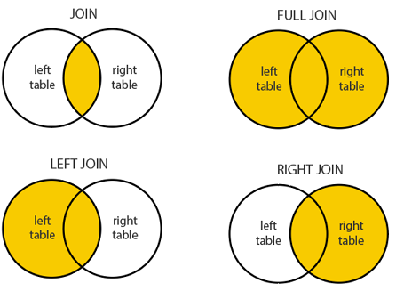
SQL FOR DATA ANALYSIS
JOIN Statement Practice

Slide 18
SQL FOR DATA ANALYSIS
INNER JOIN Statement Practice
Using the Person.Person and Person.Password tables, INNER JOIN the two tables using the BusinessEntityID column and return the FirstName and LastName columns from Person.Person and then PasswordHash column from Person.Password
2) Join the HumanResources.Employee and the HumanResources.EmployeeDepartmentHistory tables together via an INNER JOIN using the BusinessEntityID column. Return the BusinessEntityID, NationalIDNumber and JobTitle columns from HumanResources.Employee and the DepartmentID, StartDate, and EndDate columns from HumanResources.EmployeeDepartmentHistory. Notice the number of rows returned. Why is the row count what it is?
3) Expand upon the query used in question 1. Using the existing query, add another INNER JOIN to the Person.EmailAddress table and include the EmailAddress column in your select statement.

Slide 19
SQL FOR DATA ANALYSIS
INNER JOIN Statement Practice
Question 1: SELECT P.FirstName, P.LastName, PP.PasswordHash FROM Person.Person P INNER JOIN Person.[Password] PP ON PP.BusinessEntityID = P.BusinessEntityID
Question 2: SELECT E.BusinessEntityID, E.NationalIDNumber, E.JobTitle, EDH.DepartmentID, EDH.StartDate, EDH.EndDate FROM HumanResources.Employee E INNER JOIN HumanResources.EmployeeDepartmentHistory EDH ON E.BusinessEntityID = EDH.BusinessEntityID
Question 3: SELECT P.FirstName, P.LastName, PP.PasswordHash, E.EmailAddress FROM Person.Person P INNER JOIN Person.[Password] PP ON PP.BusinessEntityID = P.BusinessEntityID INNER JOIN Person.EmailAddress E ON E.BusinessEntityID = P.BusinessEntityID

Slide 20
SQL FOR DATA ANALYSIS
RIGHT & LEFT JOIN Statement Practice
1) Return the BusinessEntityID and SalesYTD column from Sales.SalesPerson. Join this table to the Sales.SalesTerritory table in such a way that every in Sales.SalesPerson will be returned regardless of whether or not they are assigned to a territory. Also, return the Name column from Sales.SalesTerritory. Give this column the column alias “Territory Name”.
2) Using the previous example as your foundation, join to the Person.Person table to return the sales person’s first name and last name. Now, only include those rows where the territory’s name is either “Northeast” or “Central”
3) Return the Name and ListPrice columns from Production.Product. For each product, regardless of whether or not it has an assigned ProductSubcategoryID, return the Name column from Product.ProductSubcategory for each product. Then, return the Name column from Production.ProductCategory for each row. Give the Name column from Production.Product the alias “ProductName”, the Name column from Production.ProductSubcategory the alias “ProductSubcategoryName”, and the Name column from Production.ProductCategory the alias “ProductCategoryName”. Order the results by the “ProductCategoryName” in descending order and then the “ProductSubcategoryName” in ascending order

Slide 21
SQL FOR DATA ANALYSIS
RIGHT & LEFT JOIN Statement Practice
Question 1: SELECT SP.BusinessEntityID, SP.SalesYTD, ST.Name AS [Territory Name] FROM Sales.SalesPerson SP LEFT OUTER JOIN Sales.SalesTerritory ST ON ST.TerritoryID = SP.TerritoryID
Question 2: SELECT P.FirstName, P.LastName, SP.BusinessEntityID, SP.SalesYTD, ST.Name AS [Territory Name] FROM Sales.SalesPerson SP LEFT OUTER JOIN Sales.SalesTerritory ST ON ST.TerritoryID = SP.TerritoryID INNER JOIN Person.Person P ON P.BusinessEntityID = SP.BusinessEntityID WHERE ST.Name IN ('Northeast', 'Central’)
Question 3: SELECT P.Name, P.ListPrice, SC.Name AS ProductSubcategoryName, C.Name AS ProductCategoryName FROM Production.Product P LEFT OUTER JOIN Production.ProductSubcategory SC ON SC.ProductSubcategoryID = P.ProductSubcategoryID LEFT OUTER JOIN Production.ProductCategory C ON C.ProductCategoryID = SC.ProductCategoryID ORDER BY ProductCategoryName DESC, ProductSubcategoryName ASC

Slide 22
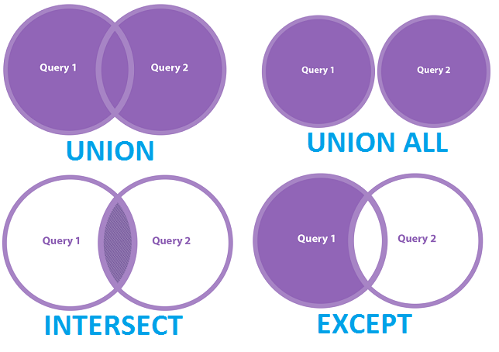
SQL FOR DATA ANALYSIS
union Statement Practice

Slide 23
SQL FOR DATA ANALYSIS
Union vs union all Statement Practice
SELECT CurrencyCode
FROM [Sales].[CountryRegionCurrency]
UNION
SELECT CurrencyCode
FROM [Sales].[Currency]
ORDER BY CurrencyCode
SELECT CurrencyCode
FROM [Sales].[CountryRegionCurrency]
UNION ALL
SELECT CurrencyCode
FROM [Sales].[Currency]
ORDER BY CurrencyCode

Slide 24
SQL FOR DATA ANALYSIS
intercept vs except Statement Practice
SELECT ProductID
FROM Production.Product
INTERSECT
SELECT ProductID
FROM Production.WorkOrder ;
SELECT ProductID FROM Production.Product
EXCEPT
SELECT
ProductID FROM Production.WorkOrder ;

Slide 25
SQL FOR DATA ANALYSIS
aggregation Statement Practice
1) How many rows are in the Person.Person table? Use an aggregate function NOT “SELECT *”.
2) How many rows in the Person.Person table do not have a NULL value in the MiddleName column?
3) What is the average StandardCost (located in Production.Product) for each product where the StandardCost is greater than $0.00?
4) What is the average Freight amount for each sale (found in Sales.SalesOrderHeader) where the sale took place in TerritoryID 4?
5) How expensive is the most expensive product, by ListPrice, in the table Production.Product?
6) Join the Production.Product table and the Production.ProductInventory table for only the products that appear in both table. Use the ProductID as the joining column. Production.ProductInventory contains the quantity of each product (several rows can appear for each product to indicate the product appears in multiple locations). Your goal is to determine how much money we would earn if we sold every product for its list price for each product with a ListPrice greater than $0. That is, if you summed the product of each product’s inventory by its list price, what would that value be? (Hint: This is intentionally challenging. You must use an aggregate function with a mathematical expression to accomplish your goal)

Slide 26
SQL FOR DATA ANALYSIS
aggregation Statement Practice
Question 1: SELECT COUNT(*) FROM Person.Person
Question 2: SELECT COUNT(MiddleName) FROM Person.Person
Question 3: SELECT AVG(StandardCost) FROM Production.Product WHERE StandardCost > 0
Question 4: SELECT AVG(Freight) FROM Sales.SalesOrderHeader WHERE TerritoryID = 4
Question 5: SELECT MAX(ListPrice) FROM Production.Product
Question 6: SELECT SUM(P.ListPrice*I.Quantity) FROM Production.Product P INNER JOIN Production.ProductInventory I ON I.ProductID = P.ProductID WHERE P.ListPrice > 0

Slide 27
SQL FOR DATA ANALYSIS
Group by Statement Practice
1) In the Person.Person table, how many people are associated with each PersonType?
2) Using only one query, find out how many products in Production.Product are the color “red” and how many are “black”.
3) Using Sales.SalesOrderHeader, how many sales occurred in each territory between July 1, 2005 and December 31, 2006? Order the results by the sale count in descending order.
4) Expanding on the previous example, group the results not by the TerritoryID but by the name of the territory (found in the Sales.SalesTerritory table).

Slide 28
SQL FOR DATA ANALYSIS
Group by Statement Practice
Question 1: SELECT PersonType, COUNT(*) AS PersonCount FROM Person.Person GROUP BY PersonType
Question 2: SELECT Color, COUNT(*) AS ProductCount FROM Production.Product WHERE Color IN ('Red', 'Black') GROUP BY Color
Question 3: SELECT TerritoryID, COUNT(*) AS SalesCount FROM Sales.SalesOrderHeader WHERE OrderDate BETWEEN '7/1/2005' AND '12/31/2006' GROUP BY TerritoryID
Question 4: SELECT ST.Name AS TerritoryName, COUNT(*) AS SalesCount FROM Sales.SalesOrderHeader SOH LEFT OUTER JOIN Sales.SalesTerritory ST ON ST.TerritoryID = SOH.TerritoryID WHERE OrderDate BETWEEN '7/1/2005' AND '12/31/2006' GROUP BY ST.Name

Slide 29
SQL FOR DATA ANALYSIS
Having Statement Practice
1) Find the total sales by territory for all rows in the Sales.SalesOrderHeader table. Return only those territories that have exceeded $10 million in historical sales. Return the total sales and the TerritoryID column.
2) Using the query from the previous question, join to the Sales.SalesTerritory table and replace the TerritoryID column with the territory’s name.
3) Using the Production.Product table, find how many products are associated with each color. Ignore all rows where the color has a NULL value. Once grouped, return to the results only those colors that had at least 20 products with that color.
4) Starting with the Sales.SalesOrderHeader table, join to the Sales.SalesOrderDetail table. This table contains the line item details associated with each sale. From Sales.SalesOrderDetail, join to the Production.Product table. Return the Name column from Production.Product and assign it the column alias “Product Name”. For each product, find out how many of each product was ordered for all orders that occurred in 2006. Only output those products where at least 200 were ordered.
5) Find the first and last name of each customer who has placed at least 6 orders between July 1, 2005 and December 31, 2006. Order your results by the number of orders placed in descending order. (Hint: You will need to join to three tables – Sales.SalesOrderHeader, Sales.Customer, and Person.Person. You will use every clause to complete this query).

Slide 30
SQL FOR DATA ANALYSIS
Having Statement Practice
Question 1: SELECT TerritoryID, SUM(TotalDue) AS TotalSales FROM Sales.SalesOrderHeader GROUP BY TerritoryID HAVING SUM(TotalDue) > 10000000
Question 2: SELECT ST.Name AS TerritoryName, SUM(TotalDue) AS TotalSales FROM Sales.SalesOrderHeader SOH LEFT OUTER JOIN Sales.SalesTerritory ST ON ST.TerritoryID = SOH.TerritoryID GROUP BY ST.Name HAVING SUM(TotalDue) > 10000000
Question 3: SELECT Color, COUNT(*) AS ProductCount FROM Production.Product WHERE Color IS NOT NULL GROUP BY Color HAVING COUNT(*) >= 20
Question 4: SELECT P.Name AS [Product Name], SUM(SOD.OrderQty) AS ProductOrderCount FROM Sales.SalesOrderHeader SOH INNER JOIN Sales.SalesOrderDetail SOD ON SOD.SalesOrderID = SOH.SalesOrderID INNER JOIN Production.Product P ON P.ProductID = SOD.ProductID WHERE SOH.OrderDate BETWEEN '1/1/2006' AND '12/31/2006' GROUP BY P.Name HAVING SUM(SOD.OrderQty) >= 200
Question 5: SELECT P.FirstName, P.LastName, COUNT(*) AS OrdersPlaced FROM Sales.SalesOrderHeader SOH INNER JOIN Sales.Customer C ON C.CustomerID = SOH.CustomerID INNER JOIN Person.Person P ON P.BusinessEntityID = C.PersonID WHERE OrderDate BETWEEN '7/1/2005' AND '12/31/2006' GROUP BY P.FirstName, P.LastName HAVING COUNT(*) >= 6 ORDER BY OrdersPlaced DESC

Slide 31
SQL FOR DATA ANALYSIS
String Statement Practice
1) Return the first eight characters of the string “This is a basic string”.
2) Return the last six characters of the string “This is another string”
3) Find the index (integer location) of the first instance of the letter “e” in each product name from the Production.Product table.
4) Find the substring of the territory name from Sales.SalesTerritory starting at the third character and lasting four characters in length.
5) Starting with the string “This is a slightly longer string”, find the last eight characters and then, from that result, find the first four characters. In other words, find the first four characters of the last eight characters from the string “This is a slightly longer string”. (Hint: use a nested function for this query)
6) Find the string that results from finding all characters to left of and including the first “e” in each FirstName from Person.Person. Only return those results where the resulting string is not blank. (Hint: this will be challenging. Use a nested function in the SELECT statement and then that same nested function in the WHERE clause)

Slide 32
SQL FOR DATA ANALYSIS
String Statement Practice
Question 1: SELECT LEFT('This is a basic string', 8)
Question 2: SELECT RIGHT('This is another string', 6)
Question 3: SELECT CHARINDEX('e', Name) FROM Production.Product
Question 4: SELECT SUBSTRING(Name, 3, 4) FROM Sales.SalesTerritory
Question 5: SELECT LEFT(RIGHT('This is a slightly longer string', 8), 4)
Question 6: SELECT LEFT(FirstName, CHARINDEX('e', FirstName, 0)) FROM Person.Person WHERE LEFT(FirstName, CHARINDEX('e', FirstName, 0)) <> ''

Slide 33
SQL FOR DATA ANALYSIS
Date Statement Practice
1) What is the month datepart for June 12, 2011?
2) What is the year datepart for November 20, 1992?
3) What day was it seventy-four days ago?
4) What is the current date? Complete this problem using at least two different date functions.
5) How many days are between April 17, 1996 and September 4, 2001?
6) How many months are between December 25, 1993 and the date that is 2,719 days before today’s date?

Slide 34
SQL FOR DATA ANALYSIS
Date Statement Practice
Question 1: SELECT DATEPART(MONTH, '6/12/2011') SELECT MONTH('6/12/2011') Question 2: SELECT DATEPART(YEAR, '11/20/1992') SELECT YEAR('11/20/1992’)
Question 3: SELECT DATEADD(DAY, -74, GETDATE())
Question 4: SELECT GETDATE() SELECT GETUTCDATE() SELECT SYSDATETIME()
Question 5: SELECT DATEDIFF(DAY, '4/17/1996', '9/4/2001’)
Question 6: SELECT DATEDIFF(MONTH, '12/25/1993', DATEADD(DAY, -2719, GETDATE()))

Slide 35
SQL FOR DATA ANALYSIS
null Statement Practice
1) If the Title column of Person.Person is NULL then return the string “No Title Listed”.
2) If the MiddleName column of Person.Person is NULL then return the string “No Middle Name Listed”.
3) If the MiddleName column is NULL then return the FirstName and LastName concatenated. If the MiddleName is non-NULL then return the FirstName, MiddleName and LastName concatenated.
4) Using the Production.Product table, if the MakeFlag and FinishedGoodsFlag columns are equal then return a NULL value.

Slide 36
SQL FOR DATA ANALYSIS
null Statement Practice
Question 1: SELECT COALESCE(Title, 'No Title Listed') AS Title FROM Person.Person
Question 2: SELECT COALESCE(MiddleName, 'No Middle Name Listed') AS MiddleName FROM Person.Person
Question 3: SELECT COALESCE(FirstName + ' ' + MiddleName + ' ' + LastName, FirstName + ' ' + LastName) AS FullName FROM Person.Person
Question 4: SELECT NULLIF(MakeFlag, FinishedGoodsFlag) FROM Production.Product

Slide 37
SQL FOR DATA ANALYSIS
cast Statement Practice
1) Write the SQL SELECT statement that returns the FirstName column of Person.Person casted as the VARCHAR data type.
2) Write three expressions in a single SELECT statement: one that returns the results of 11 divided by 4. The second column should return the result of 11 casted as float divided by 4 casted as float. The final column should divide 11.0 by 4.0 (including the decimal point and trailing zero).
3) Cast the FirstName column of Person.Person as the VARCHAR(3) data type. What happens? Why?
4) Many of the values in the Size column of the Production.Product table contain numeric values. Write a SELECT statement that returns the Size column casted as the integer data type. What is the result? Why?
5) Using the same SELECT statement that you developed in problem 4, add the WHERE clause, “WHERE ISNUMERIC(Size) = 1”. What is the result of the query now? Why? (Hint: use the MSDN articles to find how the ISNUMERIC() function is used).

Slide 38
SQL FOR DATA ANALYSIS
cast Statement Practice
Question 1: SELECT CAST(FirstName AS VARCHAR) FROM Person.Person
Question 2: SELECT 11/4, CAST(11 AS FLOAT)/CAST(4 AS FLOAT), 11.0/4.0
Question 3: SELECT CAST(FirstName AS VARCHAR(3)) FROM Person.Person
Question 4: SELECT CAST(Size AS INT) FROM Production.Product An error is returned stating “conversion failed when converting the nvarchar value ‘M’ to data type int.”. This is because there are some values of the Size column that contain sizes like “S”, “M”, “L”, etc. These values are not numeric and cannot be converted to an integer as there is certainly no integer equivalent for the value of the letter “S” or “M”.
Question 5: SELECT CAST(Size AS INT) FROM Production.Product WHERE ISNUMERIC(Size) = 1

Slide 39
SQL FOR DATA ANALYSIS
Sub query Statement Practice
1) Will the following query execute properly? Why or why not? SELECT * FROM ( SELECT P.BusinessEntityID, P.FirstName, P.LastName, YEAR(E.HireDate) FROM HumanResources.Employee E INNER JOIN Person.Person P ON P.BusinessEntityID = E.BusinessEntityID ) AS EmployeeDetails
2) Will the following query execute properly? Why or why not? SELECT * FROM ( SELECT TOP 100 P.BusinessEntityID, P.FirstName, P.LastName FROM HumanResources.Employee E INNER JOIN Person.Person P ON P.BusinessEntityID = E.BusinessEntityID ORDER BY 1 ) AS EmployeeDetails
3) Using a derived table so that no functions will appear in the WHERE clause, find all employees from the HumanResources.Employee table who were hired in the year 2006 or greater and who were born in the year 1968 or less.
4) Using a derived table, find the total sales revenue generated for the year 2005 and 2006. The WHERE and GROUP BY clause of your SELECT statement should have no functions

Slide 40
SQL FOR DATA ANALYSIS
Sub query Statement Practice
Question 1: The query will not execute because a required condition of a table expression is that each column must have a name specified. The “YEAR(HireDate)” column does not have an alias specified, therefore the table expression cannot be evaluated and the query will fail.
Question 2: This query will execute without an issue. ORDER BY clauses are not allowed in table expressions unless the TOP operator is used within the expression. Since the TOP operator is included in this table expression the ORDER BY clause is allowed.
Question 3: SELECT * FROM ( SELECT *, YEAR(HireDate) AS HireYear, YEAR(BirthDate) AS BirthYear FROM HumanResources.Employee ) AS Emp WHERE HireYear >= 2006 AND BirthYear <= 1968
Question 4: SELECT OrderYear, SUM(TotalDue) AS TotalSales FROM ( SELECT *, YEAR(OrderDate) AS OrderYear FROM Sales.SalesOrderHeader ) AS SalesOrders WHERE OrderYear IN (

Slide 41
SQL FOR DATA ANALYSIS
CTE(common table expression) Statement Practice
1) Will the following code execute properly? Why or why not? WITH Sales AS ( SELECT YEAR(OrderDate), TotalDue FROM Sales.SalesOrderHeader ) SELECT * FROM Sales
2) Using CTEs, find out, for each year the company hired new employees, how many employees the company hired for each year and how many employees they hired the previous year. Use the HumanResources.Employee table for this lab question. You should have return three columns: the hire year, the number of employees hired that year, and the number of employees hired the year before.
3) Using a CTE such that no functions are contained in the GROUP BY clause of the SELECT statement, find the number of products that began selling per year (using the Production.Product table and the SellStartDate column).
4) Using a CTE that references the Sales.SalesOrderHeader table, find each month’s total sales for the year 2006. No functions should be used in either the WHERE or the GROUP BY clause of your SELECT statement.

Slide 42
SQL FOR DATA ANALYSIS
with Statement Practice
Question 1: This query will fail at runtime because the first column of the CTE does not contain a name. Since every column in a table expression must have a name specified, the lack of a column alias will cause the query to return an error.
Question 2: WITH Hires AS ( SELECT YEAR(HireDate) AS HireYear, BusinessEntityID FROM HumanResources.Employee ), HireByYear AS ( SELECT HireYear, COUNT(*) AS HireCount FROM Hires GROUP BY HireYear ) SELECT H1.HireYear, H1.HireCount AS CurrentYearHireCount, H2.HireCount AS PriorYearHireCount FROM HireByYear H1 LEFT OUTER JOIN HireByYear H2 ON H1.HireYear = H2.HireYear + 1
Question 3: WITH Products AS ( SELECT YEAR(SellStartDate) AS ProductSellStartYear, ProductID FROM Production.Product ) SELECT ProductSellStartYear, COUNT(*) AS ProductCount FROM Products GROUP BY ProductSellStartYear
Question 4: WITH SalesMonth AS ( SELECT MONTH(OrderDate) AS OrderMonth, TotalDue FROM Sales.SalesOrderHeader WHERE YEAR(OrderDate) = 2006 ) SELECT OrderMonth, SUM(TotalDue) AS MonthlySales FROM SalesMonth GROUP BY OrderMonth ORDER BY 1

Slide 43
SQL FOR DATA ANALYSIS
case Statement Practice
1) Return the FirstName and LastName column from Person.Person. Return a third column that outputs “Promotion 1” if the EmailPromotion column value is 0, “Promotion 2” if the EmailPromotion value is 1, and “Promotion 3” if the column value is 2.
2) In a CASE statement you define conditional expressions based on column values. What happens if a value does not meet any of the conditions expressed in the CASE statement?
3) Using the Person.Person table, complete a CASE statement that returns the string “Long Name” if the FirstName column is at least ten characters long. If the FirstName column is less than ten characters, return the string “Short Name”.
4) Find out how many sales in Sales.SalesOrderHeader fell into the following ranges: “$0 to $149.99”, “$150 – 499.99”, “$500 to $4,999.99”, “$5,000 - $24,999.99”, and “Over $25,000”. Only analyze sales that had a sales person associated with them.
5) Using the Production.Product table, if the value in Color column is NULL then return the string “No Color”. If a color exists, then return that color. Complete this request two ways: once with a CASE statement, and the second with a function we have previously discussed in this guide.

Slide 44
SQL FOR DATA ANALYSIS
case Statement Practice
Question 1: SELECT FirstName, LastName, CASE WHEN EmailPromotion = 0 THEN 'Promotion 1' WHEN EmailPromotion = 1 THEN 'Promotion 2' WHEN EmailPromotion = 2 THEN 'Promotion 3' END AS PromotionName FROM Person.Person
Question 2: If a value does not meet any of the conditions in a CASE statement, the output to be returned will be a NULL value.
Question 3: SELECT CASE WHEN LEN(FirstName) >= 10 THEN 'Long Name' ELSE 'Short Name' END FROM Person.Person
Question 4: WITH SalesRanges AS ( SELECT CASE WHEN TotalDue BETWEEN 0 AND 149.99 THEN '$0 to $149.99' WHEN TotalDue BETWEEN 150 AND 499.99 THEN '$150 to $499.99' WHEN TotalDue BETWEEN 500 AND 4999.99 THEN '$500 to $4,999.99' WHEN TotalDue BETWEEN 5000 AND 24999.99 THEN '$5,000 to $24,999.99' ELSE 'Over $25,000' END AS SalesPriceRange, SalesOrderID FROM Sales.SalesOrderHeader WHERE SalesPersonID IS NOT NULL ) SELECT SalesPriceRange, COUNT(*) FROM SalesRanges GROUP BY SalesPriceRange
Question 5: SELECT CASE WHEN Color IS NULL THEN 'No Color' ELSE Color END AS Color FROM Production.Product SELECT COALESCE(Color, 'No Color') FROM Production.Produc

Slide 45
SQL FOR DATA ANALYSIS
Create, insert, update, delete Statement Practice
CREATE TABLE Employee( EmpId int,
LastName varchar(255),
FirstName varchar(255),
Address varchar(255),
City varchar(255)
);
INSERT INTO Employee (EmpId,LastName,FirstName,ADDRESS,City)
VALUES (1, 'XYZ', 'ABC', 'India', 'Mumbai' );
INSERT INTO Employee (EmpId,LastName,FirstName,ADDRESS,City)
VALUES (2, 'X', 'A', 'India', 'Pune' );
UPDATE Employee
SET FirstName= 'KS', City= 'Pune'
WHERE EmpId= 1;
DELETE FROM Employee WHERE EmpId=1;
drop table Employee

Slide 46
Window function
SELECT
ProductID,
Name,
ListPrice,
ROW_NUMBER() OVER (ORDER BY ListPrice DESC) AS RowNumber
FROM
Production.Product;
SELECT
SalesOrderID,
OrderDate,
TotalDue,
SUM(TotalDue) OVER (ORDER BY OrderDate) AS CumulativeTotal
FROM
Sales.SalesOrderHeader;
SELECT
Department.Name AS DepartmentName,
Employee.JobTitle,
PayHistory.Rate,
RANK() OVER (PARTITION BY Department.Name ORDER BY PayHistory.Rate DESC) AS RankWithinDepartment
FROM
HumanResources.Employee
INNER JOIN
HumanResources.EmployeeDepartmentHistory ON Employee.BusinessEntityID = EmployeeDepartmentHistory.BusinessEntityID
INNER JOIN
HumanResources.Department ON EmployeeDepartmentHistory.DepartmentID = Department.DepartmentID
INNER JOIN
HumanResources.EmployeePayHistory AS PayHistory ON Employee.BusinessEntityID = PayHistory.BusinessEntityID

Slide 47
Optimize query
1. Create an index on huge tables (>1.000.000) rows.
2. Use EXIST() instead of COUNT() to find an element in the table.
3. SELECT fields instead of using SELECT *
4. Avoid Subqueries in WHERE Clause
5. Avoid SELECT DISTINCT where possible.
6. Use the WHERE Clause instead of HAVING.
7. Create joins with INNER JOIN (not WHERE)
8. Use LIMIT to sample query results.
9. Use UNION ALL instead of UNION wherever possible.
10. Use UNION where instead of WHERE ... or ... query.
11. Run your query during off-peak hours.
12. Avoid using OR in join queries.
13. Choose GROUP BY over window functions.
14. Use derived and temporary tables.
15. Drop the index before loading bulk data.
16. Use materialized views instead of views.
17. Avoid != or <> (not equal) operator
18. Minimize the number of subqueries.
19. Use INNER join as little as possible when you can get the same output using LEFT/RIGHT join?
20. Frequently try to use temporary sources to retrieve the same dataset.

Slide 48
Optimize query
Indexing:
Proper indexing is one of the most effective ways to speed up query execution.
Create indexes on columns that are frequently used in WHERE clauses, JOIN conditions, and ORDER BY clauses.
Be mindful of the trade-off, as indexes can slow down write operations and consume more storage.
Avoid Unnecessary Columns:
Only select the columns you need. Using SELECT * retrieves all columns, which can be inefficient, especially with tables containing a large number of columns or large data types.
Reducing the amount of data being returned by the query can significantly improve its performance.
Optimize JOINs:
Ensure that you are using the most efficient type of join for your query and data structure (e.g., INNER JOIN, LEFT JOIN, etc.).
When possible, avoid joining large tables. If you must, ensure both tables are indexed appropriately on the join condition.
Use WHERE Clauses Effectively:
Filter data as early as possible using WHERE clauses to reduce the amount of data processed by the database engine.
Be cautious with functions or calculations in WHERE clauses, as they can prevent the use of indexes.
Query Execution Plans:
Make use of the query execution plan feature available in most database management systems.
Execution plans can help identify bottlenecks, such as table scans or inefficient joins.
Adjust your query or schema based on the insights from the execution plan.
Additional Tips:
Subquery and Temporary Table Usage: Sometimes breaking down a complex query into simpler subqueries or using temporary tables can improve performance.
Avoiding OR Conditions in WHERE Clauses: OR conditions can make it difficult for the query optimizer to use indexes effectively. Rewriting queries using UNION or other strategies can sometimes yield better performance.
Proper Use of Aggregates and Grouping: Aggregates (like COUNT, AVG) and GROUP BY clauses can be resource-intensive. Ensure they are used judiciously and only when necessary.

